Slide 1

CAPSTONE PROJECT
Recipe Preparation Agent
Presented By:
Student name : Amit Ramchandra Mali
College Name & Department : MIT Academy Of Engineering, Electronics & Telecommunication

Slide 2
OUTLINE
Problem Statement
Technology used
Wow factor
End users
Result
Conclusion
Git-hub Link
Future scope
IBM Certifications

Slide 3
Problem Statement
In today's fast-paced lifestyle, individuals often struggle to decide what meals to cook with the limited ingredients available at home. This leads to unnecessary grocery trips, increased food waste, and time inefficiencies. Our project aims to solve this problem by developing an AI-powered Recipe Preparation Agent that uses a Retrieval-Augmented Generation (RAG) system to suggest customized recipes based on the user's available ingredients. The agent, built on IBM Cloud Lite services and leveraging IBM Granite Foundation Models, will generate step-by-step cooking instructions, provide ingredient substitutions, and adapt to dietary preferences—making daily cooking more efficient, sustainable, and user-friendly.

Slide 4
Technology used
IBM cloud lite services
Retrieval Augmented Generation (RAG)
IBM Granite model

Slide 5
IBM cloud services used
IBM Cloud Watsonx AI Studio
IBM Cloud Watsonx AI runtime
IBM Cloud Agent Lab
IBM Granite foundation model

Slide 6
Wow factors
This AI agent revolutionizes everyday cooking by transforming basic pantry ingredients into delicious meal suggestions. It empowers users to save time, reduce food waste, and make healthier food choices with the help of real-time, intelligent recipe retrieval.
Unique features:
Ingredient-based recipe discovery using Retrieval-Augmented Generation (RAG)
Smart substitution suggestions for missing or unavailable ingredients
Step-by-step cooking guidance sourced from trusted recipe documents
Dietary adaptation for vegetarian, vegan, or low-fat preferences
Health-conscious filtering (e.g., low-oil, high-protein options)
Conversational & multilingual support for a friendly and inclusive cooking experience

Slide 7
End users
Students and Hostelers
Home Cooks & Parents
Health-Conscious Individuals
Users in Rural/Semi-urban Areas

Slide 8
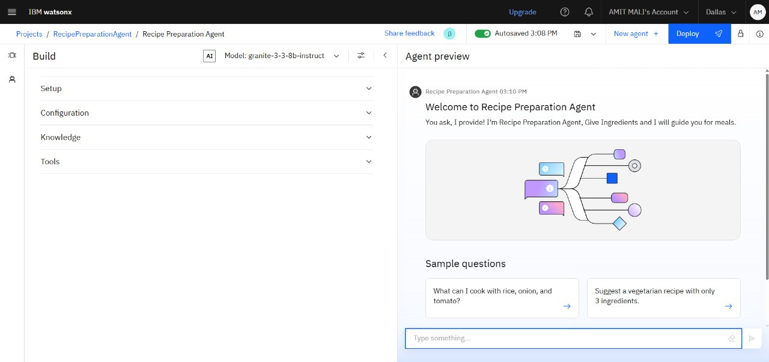
Results

Slide 9
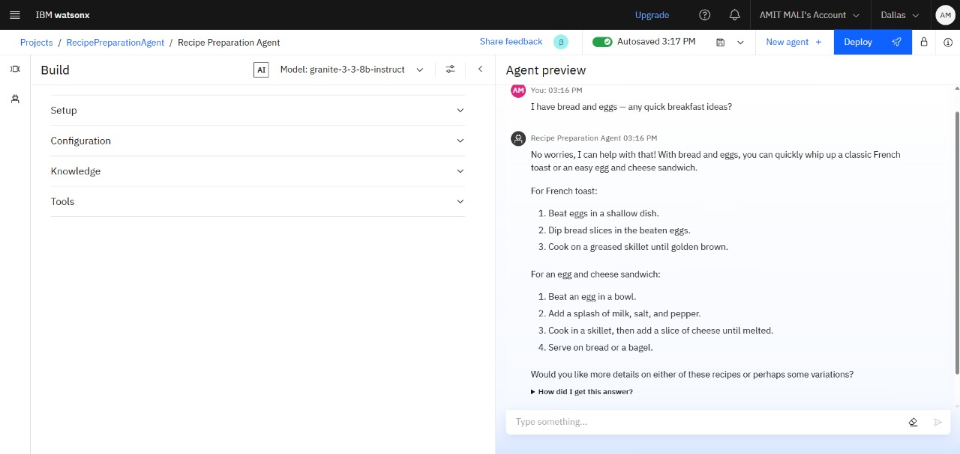
Results

Slide 10
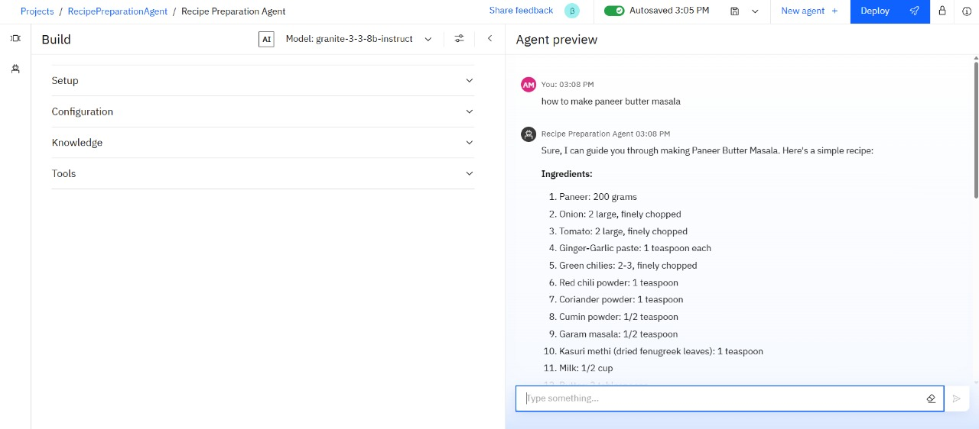
Results

Slide 11
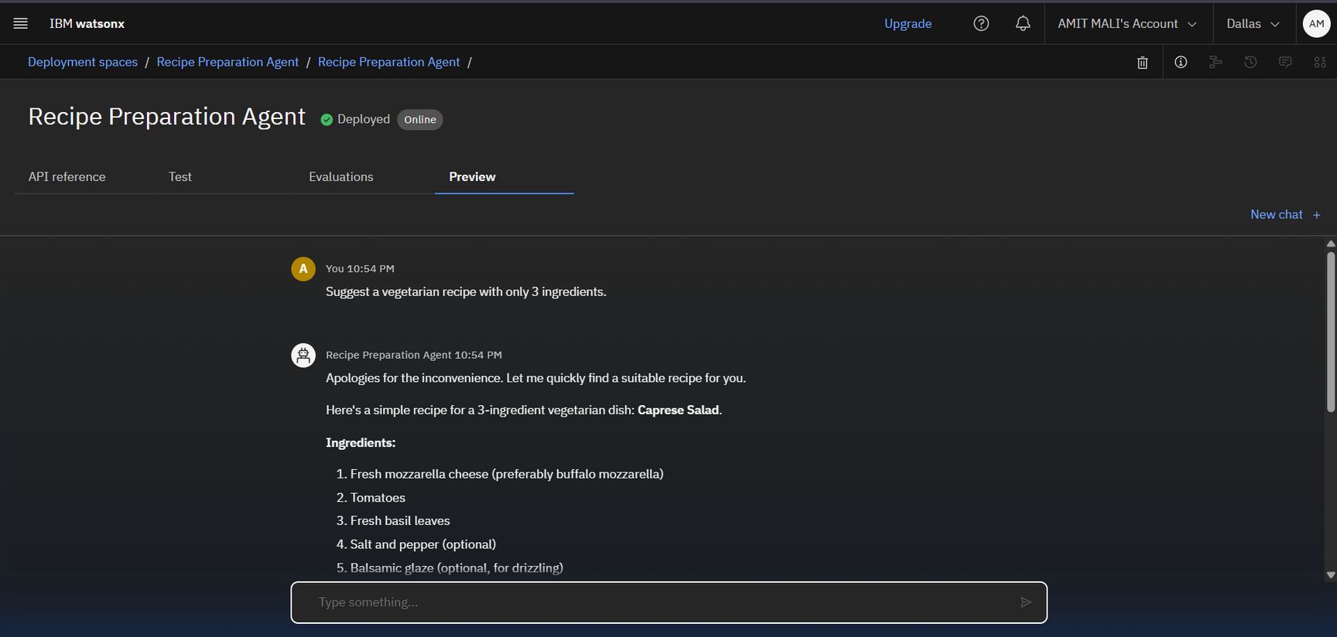
Results
Deployed AI Agent

Slide 12
Conclusion
The agent helps users cook smart meals by suggesting recipes based on available ingredients.
It saves time, reduces food waste, and promotes healthier eating through AI-driven personalization.
Recipe Preparation Agent enhances everyday cooking experiences by offering substitutions, step-by-step guidance, and dietary customization in a conversational, user-friendly way.

Slide 13
Future scope
Voice Integration for Smart Assistants
Multilingual Support with Regional Recipes
Image Input (Multimodal AI)
Health-Aware Personalized Meal Plans
Grocery List & Inventory Tracker
AI-Assisted Paper Drafting

Slide 14
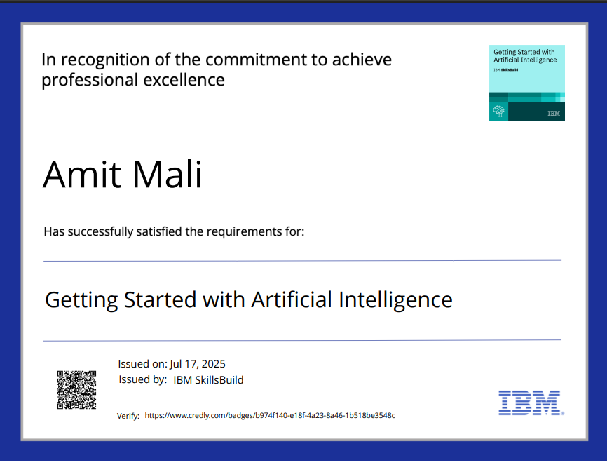
Screenshot/ credly certificate( getting started with AI)
IBM Certifications

Slide 15
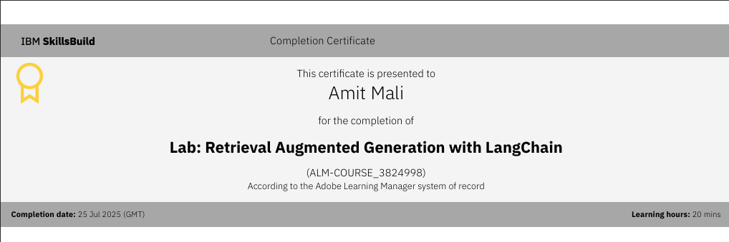
Attach your RAG LAB certificate here

Slide 16
Github Link
Git hub link :
https://github.com/Amitmali72/Recipe-Preparation-Agent-IBM

Slide 17
THANK YOU

